Slide 1
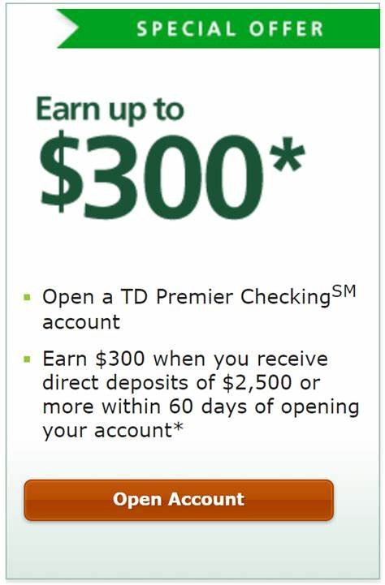
Bank Marketing
Problem type: Classification

Slide 2

There has been a revenue decline in a Private Bank and they would like to know what actions to take.
After investigation, they found that the root cause was that their customers are not investing enough for long term deposits.
So the bank would like to identify existing customers that have a higher chance to subscribe for a long term deposit and focus marketing efforts on such customers.
Problem Statement
Select customers who are
More likely to subscribe
Based on their potential what action to take.

Slide 3
Target: Classify potential subscriber
Solution is
The decision maker needs to know,
List of persons who will subscribe
What promotional offer should be taken for each person
What would be the mechanism of reaching them
Target
Subscription Probability
Region
Demographics
Financial
Marketing
Age
Sex
Marital Status
Previous marketing campaign
Methods of reach
Debt
Asset
Credit ratings

Slide 4
Bank Marketing Data
Bank client data:
Age (numeric)
Job : type of job (categorical: 'admin.', 'blue-collar’, etc
Marital : marital status (categorical: 'divorced', 'married', 'single’ etc;
Education (categorical: 'basic.4y', 'basic.6y', 'basic.9y', 'high.school', 'illiterate’,
Default: has credit in default? (categorical: 'no', 'yes', 'unknown')
Housing: has housing loan? (categorical: 'no', 'yes', 'unknown')
Loan: has personal loan? (categorical: 'no', 'yes', 'unknown')
Social and economic context attributes
Emp.var.rate: employment variation rate - quarterly indicator Cons.price.idx: consumer price index - monthly indicator (numeric)
Cons.conf.idx: consumer confidence index - monthly indicator
Euribor3m: euribor 3 month rate - daily indicator (numeric)
Nr.employed: number of employees - quarterly indicator (numeric)
Other attributes:
Campaign: number of contacts performed during this campaign
Pdays: number of days that passed by after the client was last contacted from a previous campaign (numeric; 999 means client was not previously contacted)
Previous: number of contacts performed before this campaign and for this client (numeric)
Poutcome: outcome of the previous marketing campaign (categorical: 'failure','nonexistent','success')
Related with the last contact of the current campaign:
Contact: contact communication type (cat:
'cellular','telephone')
Month: last contact month of year (catl: 'jan', ‘feb etc Dayofweek: last contact day of the week (catl: 'mon','tue’, etc')
Duration: last contact duration, in seconds (numeric).

Slide 5

So lets Run with a Robot AI…..

Slide 6
Get the decision with 4 steps
Login
Name Project “Banking”and Solution Name “Bank Marketing”→ Classification → Click create project
Data
Build Model
Name your data “Marketing Data” → upload bank_marketing_train.csv
Select target. Choose “subscribe” as your target
A window will pop up asking you run the preliminary analysis or not. Press Yes Button
Preliminary analysis will run-→see result in Confusion Matrix and Prediction KPI for error
Press Next→ land in “build Model page
Select Variables: duration, pdays, emp.var.rate, cons.conf.idx, nr.employed
Normalization: Yes
Shuffle: Yes
Cross-Validation: 5-fold
Accuracy Metric: Recall
Select Algorithm
Linear Regression
Random Forest
XGBoost
Click on Train
Click on Finalize
You will land on Deploy page

Slide 7
Get the decision with 4 steps
Deploy
Decision
Click on Add data→
upload new data from CSV source from you computer bank_marketing_pred.csv file
A variable list will show up→ click on skip
Go to Data Post Process
Go to Result Configuration
Check download as CSV
Select Algorithm
Random forest
Press “Predict”, prediction will running
Press Next→ you will land in Decision Page
Select Decision Scenario Tab
Change slider value for different variables
Press Apply
Do the step until Target or Target desired value is higher or lower or middle

Slide 8


